Slide 1

Notes:
HOW TO BEGIN THE PRESENTATION
What do you do for work right now (John)?
How long have you been doing that? What keeps you there?
How about you (Mary), What do you do right now?
How long have you been doing that? What keeps you there?
“What did (APFA) tell you about us? Great. I guess I get to tell you everything then.
By the way (APFA) is in training tonight so after I start he/she doesn’t get to talk.
The name of our company is Primerica. Have you heard of us before? Well, my responsibility with the company is two-fold:
First, it’s to help people make smart choices about money.
My second responsibility - and really the most important one is to help the company expand in this area. We are expanding our outlets and looking for some quality, motivated individuals who might want to help us do that. Right now we have about 45 outlets in BC and the company wants 300 so I am always on the lookout for sharp individuals. On the way over here (Trainee) said you were (extremely ambitious? Hard-working? Success-driven?). Right now the average income of the people running these outlets is $120,000. I understand you are probably set career-wise. But after we go through this, and if you see the information is valuable, see the potential for our market and like what we do - would you be offended at all if I invited you to our office for about an hour or so to take a look at an opportunity which could produce that kind of income for you? WFA
If not interested: “Fair enough, I didn’t know whether you would be interested or not but you may know two or three sharp people who would want to take advantage of something like this, that you could refer to (Trainee), OK?
Great, let’s get started...”

Slide 2

The Largest Independent Financial Services Marketing Company in North America with 150,000+ Licensed Representatives
Listed on the New York Stock Exchange (PRI)
In Business Since 1977
More Than 5.7 Million Lives Insured and 3 Million Investment Clients
$951 billion of life insurance in force
More than $105 billion in assets under management*
Notes:
Read slide

Slide 3




















Strategic Partners
CRITICAL ILLNESS
INSURANCE
TRAVEL
INSURANCE
Common Sense Funds
An investment program for every phase of life
PFSL Investments Canada
Mutual Fund Dealer
HEALTH &
DENTAL INSURANCE
SMALL BUSINESS GROUP
BENEFITS
SEGREGATED
FUNDS
DISABILITY
BENEFITS
MUTUAL
FUNDS
Primerica Life Insurance
Company of Canada
LIFE
INSURANCE
GUARANTEED ISSUE
DEBT
SOLUTIONS
CLIENT
SOLUTIONS
LEGAL
SERVICES
MORTGAGES
& REFINANCING
DEBT ELIMINATION &
CONSOLIDATION
HOME & AUTO
INSURANCE
Notes:
Touch base on all we do with our partners

Slide 4
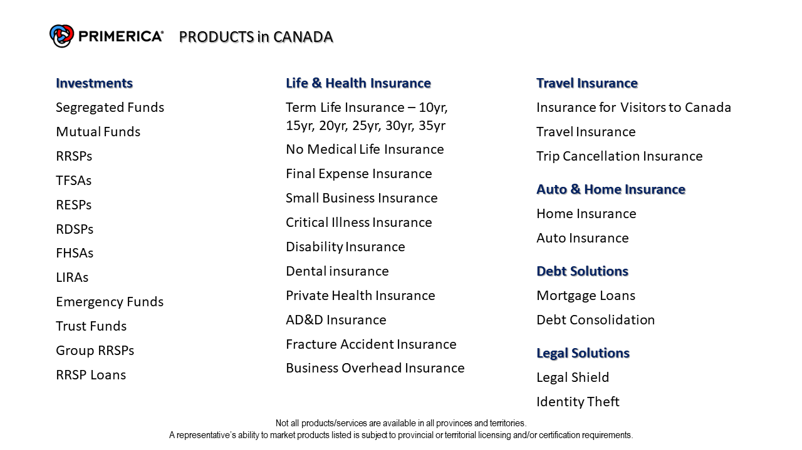
Notes:
Touch base on all we do with our partners for the products, touch on a couple of them

Slide 5


Notes:
We help to build you a Financial house

Slide 6
Why Are People Having So Many Financial Challenges?
Most People Today Don’t…
Our Mission Statement
Get a Financial Education
To help families earn more income and become properly protected,
debt free and financially independent.
Have a Financial Game Plan
Have a Financial Coach
This results in serious challenges for families.
Notes:
THIS IS THE MONEY PART. MOST OF US HAVE NEVER GOTTEN A FINANCIAL EDUCATION, WE DON’T HAVE A FINANCIAL GAMEPLAN & WE DON’T HAVE A FINANCIAL COACH, IF YOU DON’T KNOW WHAT YOU ARE DOING, YOU DON’T HAVE A GAMEPLAN OR A COACH CHANCES ARE YOU ARE GOING TO LOSE.
OUR MISSION IS TO Help Families WHO DO YOU KNOW WANTS TO EARN MORE MONEY? WHO DO YOU KNOW IF THEY LOVE THEIR FAMILY WANTS TO PROPERLY PROTECT THEM? WHO WOULD WANT TO GET OUT OF DEBT? Who would want to accumulate enough money COULD Retire and live off their money & BE FIN IND? BIG MARKET, HUGE MARKET
LOTS of PEOPLE NEED WHAT WE DO.

Slide 7

What’s Important About Money To You?
Debt Free
Educate Children
Retirement
Emergency
Funds
Lower Financial
Stress
Travel
Support Parents
Better Lifestyle
Charities
Security
Freedom
More Time
Sense of
Accomplishment
Notes:
“John & Mary, a lot of people think my job is to market investments & RRSP’s, insurance’s & debt management products to help people achieve specific goals like a secure retirement or funding the children’s education. I do that, but my most important function is to help my clients achieve their lifetime financial goals. To be effective I need to understand the big picture. The key ingredient in all your financial goals is enough money to achieve them. So, help me understand: What's important about money … to you?”
(TURN PAGE ONCE YOU HAVE ASKED THE QUESTION)
That’s great ________, if I can put together a game plan where I could show you how to become (repeat back the answers) and ultimately allow you to achieve (last answer given) do you think we would have a basis to work together? WFA
Awesome I am so excited to be able to work with you as well.

Slide 8
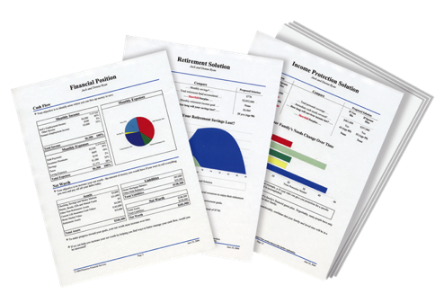

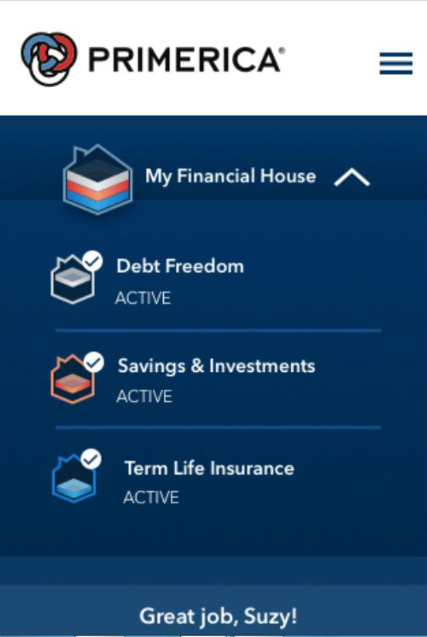
People Don’t Plan to Fail, They Fail to Plan
The Problem for most people:
No Clear Direction
The Solution:
A complimentary cutting-edge digital tool that works like a GPS, but it’s for your money.
A clear route from where we are, to where we want to go, so we can worry less about money and enjoy life more!
We know what we want,
but get confused at times on how to get there.

Slide 9

Do You Know Your Financial Independence Number?
Take a 35-year-old wanting to retire in 30 years, with $30,000 a year
($2,500 per month)…
65
Your FIN# is $1,080,000
30 years from now, after 3% inflation… $73,000 spends like $30,000 does today.
Income
Growth
35
85
Your FIN is $1,080,000
Having an investment plan without knowing your FIN# is like going on a road trip without a destination.
Retirement is no longer an age,
Retirement is a number.
This hypothetical example assumes 20 years of retirement income needed, at a 6% post-retirement rate of return and 3% inflation. Hypothetical investment rates assume a nominal 9% rate of return, compounded monthly, and are not indicative of any specific investment. Any actual investment may be subject to taxes and fees, which would lower performance. This example shows a constant rate of return, unlike actual investments which may fluctuate in value.
Notes:
Explain the FIN

Slide 10
The Rule of 72
Divide your interest rate into 72 to find the approximate number of years it takes for money to double.
Years
3%
6%
12%
How do you win a game if you don’t know the rules?
Who would benefit from learning this rule?
Shouldn’t we have learned this rule in school?
19 - 0
$10,000
$10,000
$10,000
6
12
18
24
30
36
42
67 - 48
$20,000
$20,000
$40,000
$80,000
$20,000
$40,000
$160,000
$320,000
$80,000
$640,000
$1,280,000
$40,000
$160,000
$2,560,000
What kind of results are your investments getting?

Slide 11


Bypass the Middleman – Become an Owner, Not a Loaner
Traditional Financial Institutions
Your Money
Global Economy
Traditional Institutions = Historically Low Rates of Return
GICs and savings/chequing accounts are generally CDIC insured up to $100,000. Cash value life insurance offers life insurance components in addition to the investment component.
.

Slide 12



The Three Accounts One Needs
To have a complete savings program,
most people need three types of basic accounts.
Emergency Fund
Short-Term Savings
Long-Term Savings or Investments
Investing entails risk including loss of principal. Units, when redeemed, may be worth more or less than original value.

Slide 13

What if you had a toaster in your kitchen, and on the 1st and 15th of every month $2,000 popped out of it?
Income Protection
Would you like that toaster?
Would you insure it?
Unfortunately, there is no such toaster, but you are the money machine for your family.
So if it makes sense to insure an imaginary toaster, wouldn’t it make sense to insure your income?

Slide 14
The Theory of Decreasing Responsibility
P
$
FIN#
DYING
TOO SOON
LIVING TOO LONG
$
P
Today
Young children
High debt
House mortgage
Loss of income would be devastating
At Retirement
Grown children
Lower debt
Mortgage Paid
Retirement income needed
What life insurance company do you know of that
teaches people how to eliminate the need for life insurance?

Slide 15
Solution: Build Your Financial House
HOME INSPECTION
5. Other Goals & Dreams
Generation to Generation Investment
Goal: develop a family tradition of financial success & independence!
How much of an inheritance do you want to leave your Family?
4. Investments
Do you know your financial independence number?
What exactly is your retirement income strategy?
Retirement Planning (RRSP, TFSA)
College Planning (RESP)
Saving for a house
3. Debt Reduction
Have a plan to eliminate debt as quickly as possible?
2. Budget - Emergency Fund - Will
Have 3-6 months of expenses in an emergency fund?
Have a Will and durable Power of Attorney?
1. Protect Your Income
Have enough individual life insurance to replace your income in the event of a premature death?
Do you currently have a written financial game plan that addresses these strategies in your financial house?
On a scale of 1-10, 10 being the highest,
How would you rate your desire to become debt free and financially independent?
Notes:
Read each line and ask question. Write the answers down

Slide 16

The Financial Blueprint
A Financial Needs Analysis (FNA), is like a Financial GPS, it is the blueprint for building a financial house.
If we can design a strategy or game plan, using an F.N.A., to help you achieve your short-term and long-term financial goals, would we have a basis for working together?

